Slide 1
Proteomics

Slide 2
What is proteomics ?
Proteomics:
(Large scale) identification and characterization of proteins and all their properties
Which proteins are present at a certain location and time?
Are they post-translationally modified?
With which other proteins do they interact?
What is their 3D structure?
What is their function?
Notes:
What now is proteomics exactly? When you do proteomics you would like to study a complete set of proteins. You would want to know which proteins are present at a certain location in the cell at a specific moment. Are those proteins post-translationally modified? With which other proteins do they interact. What is their 3D structure and of course what is their function. Of course it is not possible, at least not at the moment, to look at all proteins at the same time and answer all these questions. Therefore we rephrased the term proteomics into large-scale identification and characterization of proteins.

Slide 3
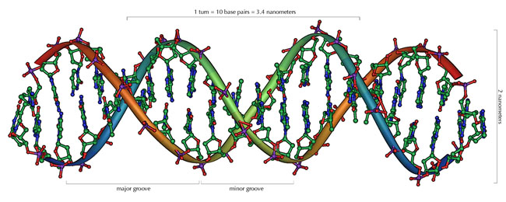
Challenges in proteomics
DNA/RNA has 4 building blocks and a uniform structure
Proteins have 20 building blocks, highly variable structure, hydrophobicity, charge and undergo many post-translational modifications
Proteins need a functional correctly folded state for most proteomics applications
http://serc.carleton.edu/microbelife/research_methods/genomics/index.html
Notes:
Proteins are much more difficult to characterize and work with than nucleic acids.
DNA/RNA has 4 building blocks and a (mainly) uniform hydrophilic negatively charged structure
Proteins have 20 building blocks, highly variable structure, hydrophobicity, and charge
Proteins need to be kept in a functional correctly folded state for most proteomics applications
This is probably the reason that people did a lot more research on genes and genomes than on proteins. However proteomics is much more interesting than the other omics for a lot of practical applications. For example most drugs act on proteins, not nucleic acids, and enzymes, not nucleic acids, are used as catalysts in bioprocessing applications.

Slide 4
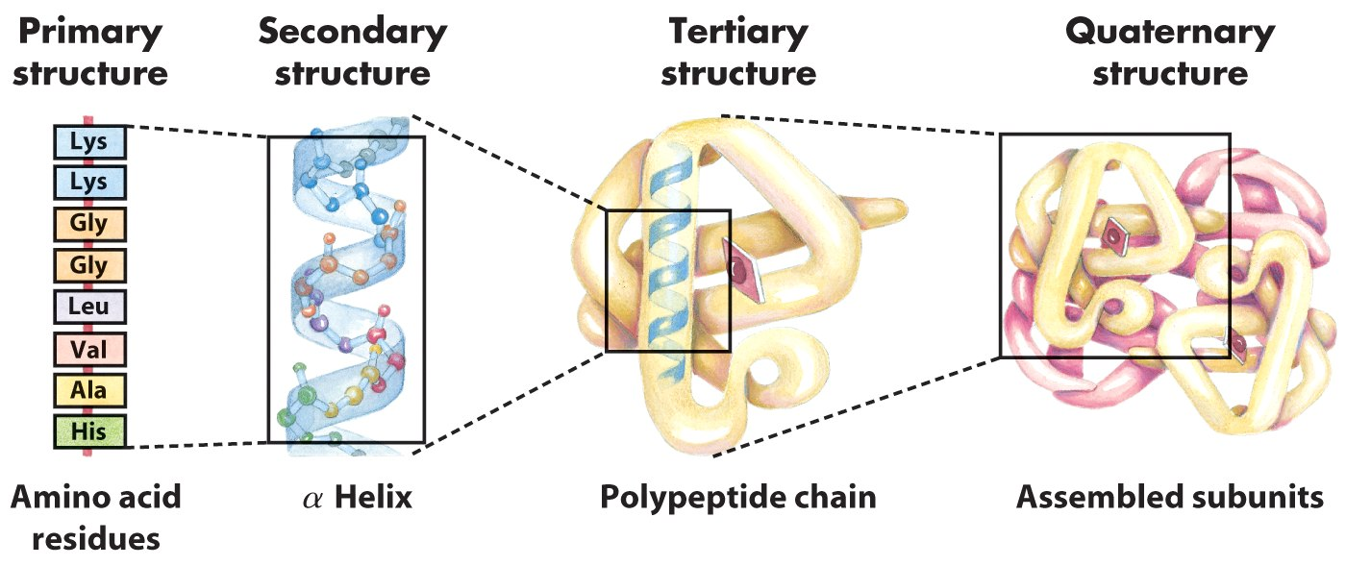
1D → 4D
Lehninger, 4th ed. Fig. 3-16

Slide 5
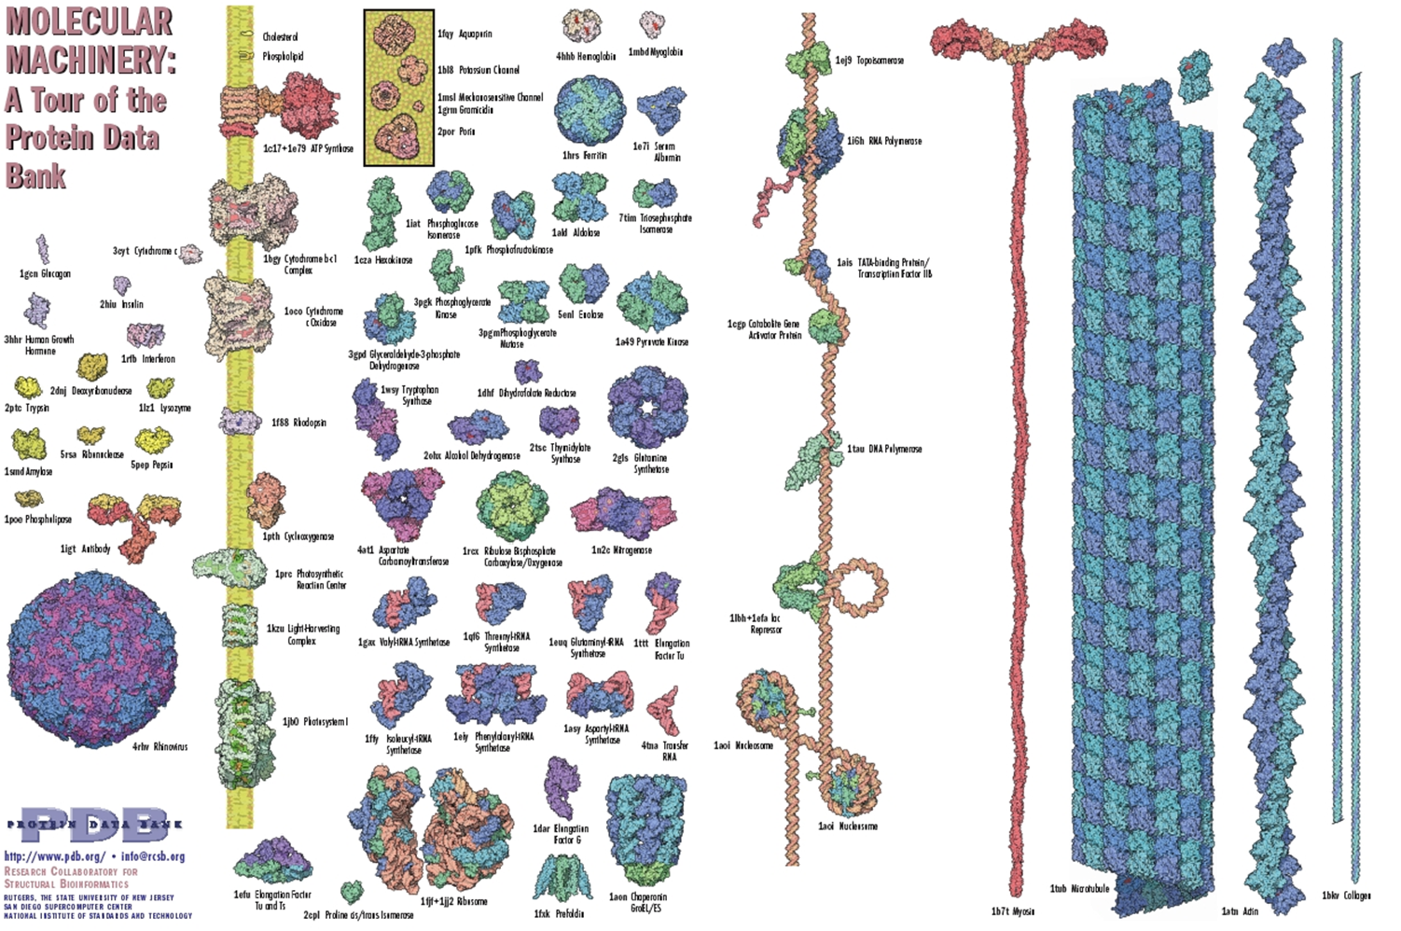
Proteins are very diverse
http://www.rcsb.org/pdb/101/static101.do?p=education_discussion/educational_resources/index.html#Posters-Exhibits

Slide 6
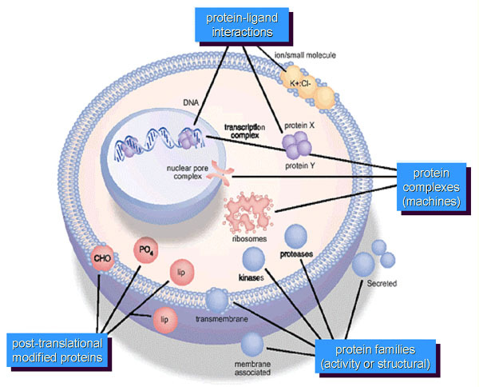
Proteins have diverse properties
Protein-ligand interactions
Protein localisation
Protein-
protein interactions
Proteolytic
cleavage
Patterson & Aebersold, Nature Genetics (supp.), 33, 311 (2003)
Post-translational
modified proteins
Protein families
(activity or structural)
Notes:
Each protein can be post-translationally modified, which might lead to activation, inactivation or a different function of the protein. The same is true for proteolytic cleavage, where a small piece of the protein is cleaved from the protein. In addition, each protein is located in a special place in the cell. When it is brought to another location the function of the protein can change due to the presence of different binding partners. For example here, the protein ligand interactions. In the cytoplasm they will bind to each other the result of which is that the whole complex is brought to the nucleus where it can enhance gene expression. The same is true for protein-protein interactions. When a protein is in complex with a certain protein it can have function 1 and when it is in complex with another protein it can have function 2.

Slide 7
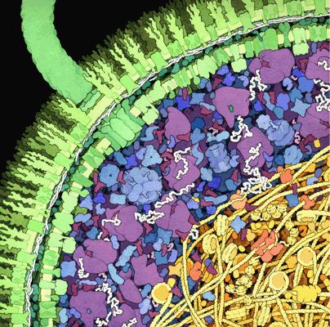
Challenges in proteomics
Proteins are present in a large range of concentrations
Proteins undergo post-translational modifications
When is a protein active?
Proteases are everywhere
Sampling
David Goodsell 1999
http://mgl.scripps.edu/people/goodsell/illustration/public/
Notes:
Due to higher number of different proteins higher specificity of detection method is needed. Large range of concentrations.
Sometimes different functions due to different modfications. Sometimes proteins have different function due to modification or location in the cell.
And when is protein functionally active?
When you isolated your proteins you should be very carefull that they do not degrade, because proteases are everywhere.
So there comes the key-word for proteomics, which is sampling. Sampling means that you are very careful in making a protein sample that preferentially contains only those proteins you are interested in, for example the proteins from a certain cell type, or only the phosphorylated proteins.

Slide 8
Proteomics techniques
Protein function
Biochemical assays
Protein micro-arrays
Post-translational modifications
MS or MS/MS
Protein separation
2D gels
Liquid chromatography
Protein identification
MS or MS/MS
Protein micro-arrays
3D structure determination
X-ray
NMR
Homology modelling
Protein-protein interactions
Yeast two-hybrid
Affinity chromatography + MS
In silico techniques
Protein micro-arrays
Notes:
Besides doing biochemcial assays, determining the 3D structure of a protein, further insight into the function of a protein can be obtained by finding out to which proteins each protein can bind.

Slide 9
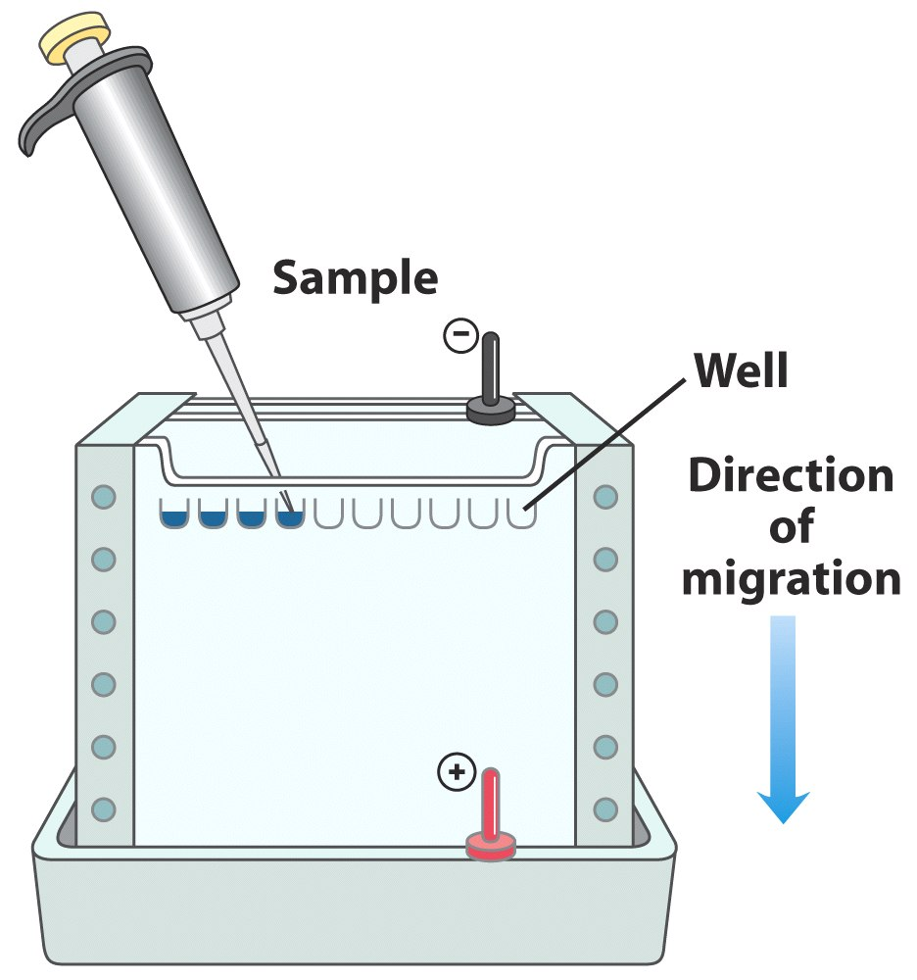
SDS-PAGE
Lehninger, 5th ed. Fig 3-18

Slide 10
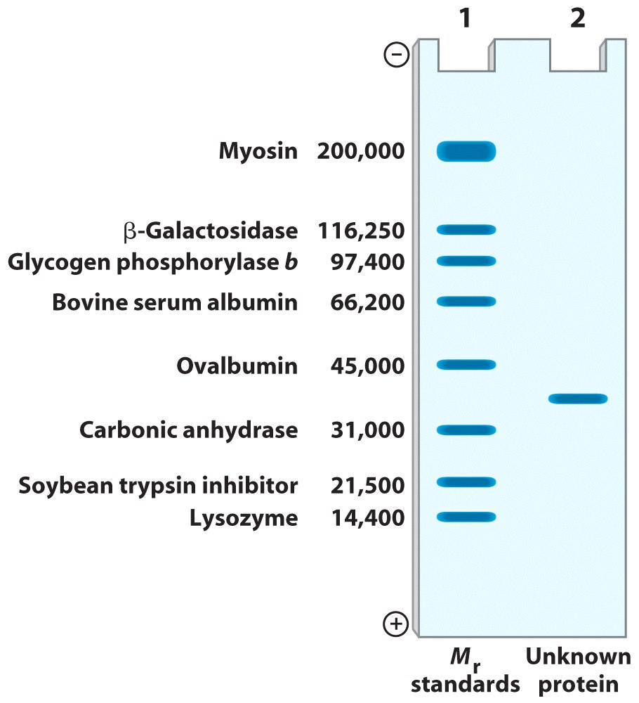
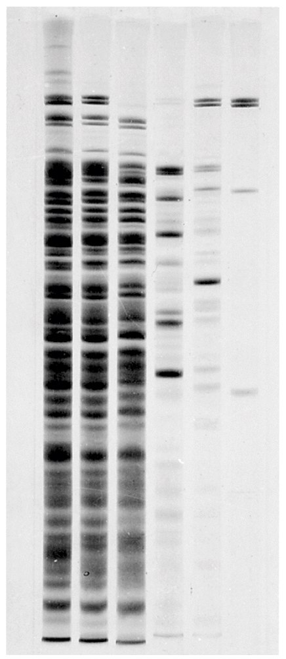
Lehninger, 5th ed. Fig 3-19, 3-20

Slide 11
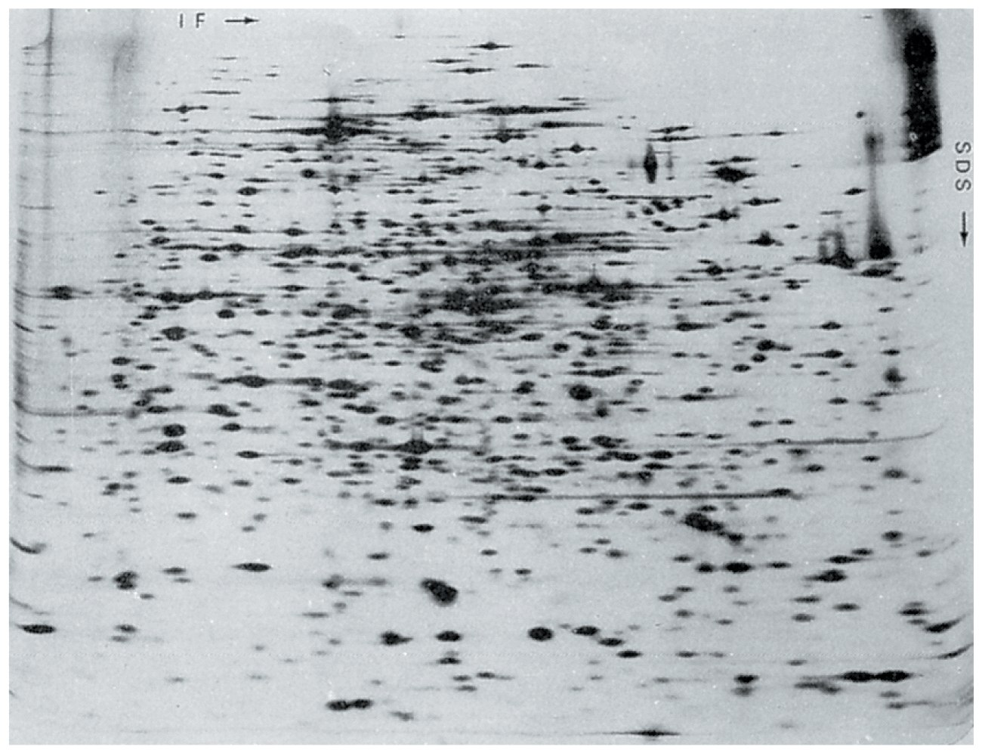
2D-gel: IE + SDS-PAGE
http://www.expasy.ch/ch2d/

Slide 12
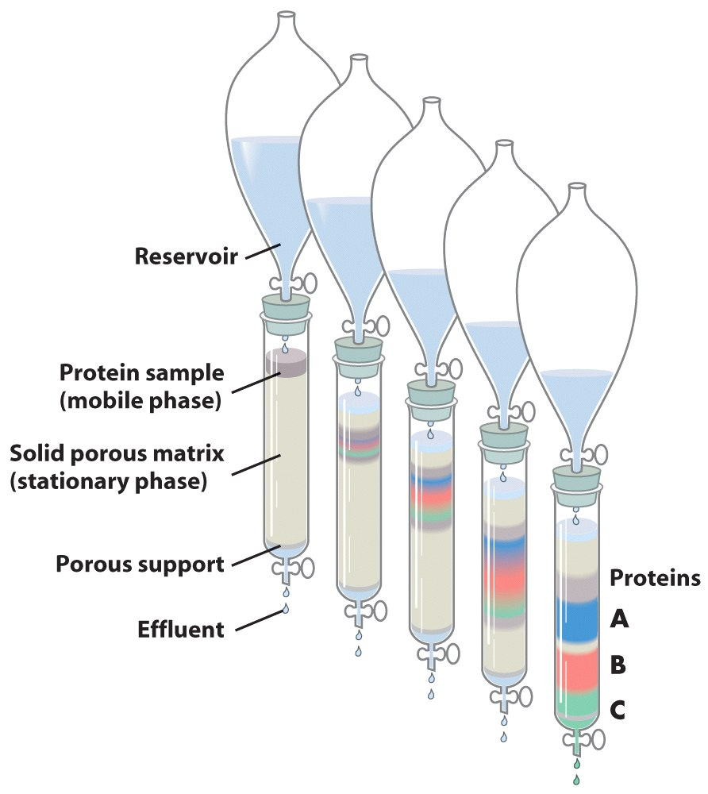
Chromatografy
Lehninger, 5th ed. Fig 3-16

Slide 13
Proteomics techniques
Protein function
Biochemical assays
Protein micro-arrays
Post-translational modifications
MS or MS/MS
Protein separation
2D gels
Liquid chromatography
Protein identification
MS or MS/MS
Protein micro-arrays
3D structure determination
X-ray
NMR
Homology modelling
Protein-protein interactions
Yeast two-hybrid
Affinity chromatography + MS
In silico techniques
Protein micro-arrays
Notes:
Besides doing biochemcial assays, determining the 3D structure of a protein, further insight into the function of a protein can be obtained by finding out to which proteins each protein can bind.

Slide 14
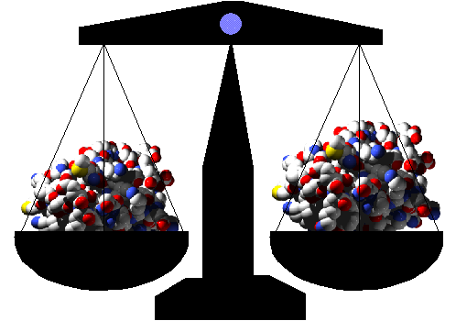
Mass Spectrometry
Analytical method to measure the molecular weight of molecules
Eiwit gevisualiseerd mbv yasara.com
http://rwbforever.tripod.com/laws.htm
Notes:
Mass spectrometry is …, nothing more, nothing less. A mass spectrometer can separate proteins or fragments based on its mass and its charge. If you know the charge, you know the weight.

Slide 15
Proteomics techniques
Protein function
Biochemical assays
Protein micro-arrays
Post-translational modifications
MS or MS/MS
Protein separation
2D gels
Liquid chromatography
Protein identification
MS or MS/MS
Protein micro-arrays
3D structure determination
X-ray
NMR
Homology modelling
Protein-protein interactions
Yeast two-hybrid
Affinity chromatography + MS
In silico techniques
Protein micro-arrays
Notes:
After protein identification you know what kind of proteins are in the mixture you are analysing. But what you would like to know is how these proteins function and how they function together.
Besides doing biochemcial assays to determine the function of proteins finding out the three dimensional structure of the protein can give further insight into the function of a protein.

Slide 16
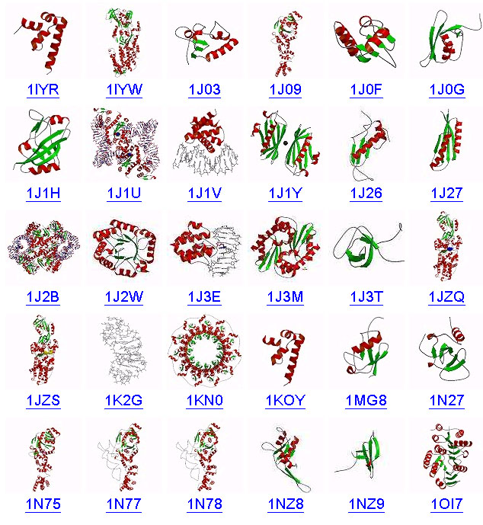
Protein Structure
Many protein structures already determined
X-ray, NMR
One database: PDB
www.rcsb.org
www.pdb.org
www.pdb.org
Notes:
Although proteins are build out of 20 amino acids they fold into a wide variety of structures.
For many proteins the structure is already determined. With techniques like X-ray crystallography or NMR.
Al these structures are brought together in the PDB database.

Slide 17
PDB database 2017
Exp.Method | Proteins | Nucleic Acids | Protein/NA Complexes | Other | Total
X-RAY | 111813 | 1878 | 5711 | 4 | 119406
NMR | 10488 | 1223 | 245 | 8 | 11964
Electron Microscopy | 1235 | 30 | 432 | 0 | 1697
Hybrid | 102 | 3 | 2 | 1 | 108
Other | 199 | 4 | 6 | 13 | 222
Total | 123837 | 3138 | 6396 | 26 | 133397
http://www.rcsb.org/pdb/statistics/holdings.do

Slide 18
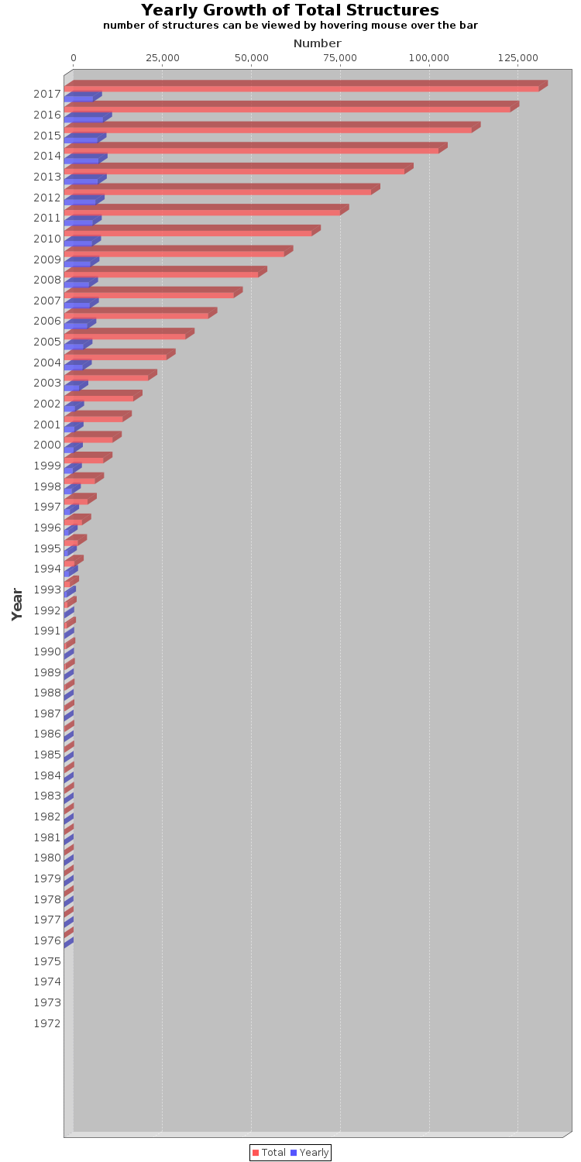
PDB database
Nr. of protein 3D structures
Sept 2017: 133.397
With these structures available it is now possible to know for 80% of all proteins in Nature the structural topology
yearly
total
How is this achieved ?
http://www.rcsb.org/pdb/statistics
Notes:
At the moment there are about 29 thousand 3D structures in the database. Here you see an overview of the content of the PDB database and how many structures are added yearly. As you can see these last years there is an enormous increase in protein structures that are being determined. With this speed of determining 3D structures it is expected that at the end of 2007 there are 50.000 structres available in the database. With this amount of structures known it is possible to determine for 80% of all proteins in nature how they are folded. But is this achieved?

Slide 19
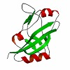
Protein Structure
Proteins are build from α-helices, β-strands and loops
Proteins resemble each other: “folds”
Try to identify 3D structure for at least 1 member of each “fold”
3D structure from rest of family determined using
homology modelling.
This works well when the sequence identity is > 25%
http://expasy.org/proteomics/protein_structure
www.pdb.org
Notes:
In general you can say that a protein is build out of helices, strands and loops. The possibilities with these building blocks is not unending, because not all possibilities result in a stable protein. There are many proteins that resemble each other. You can then say that they have a similar fold.
What people are now trying to do it to determine the structure for at least one member of each fold. Based on this structure it is then possible to determine the structure of the rest of the fold-family using homology modelling. Homology modelling works well when there is a sequence identity between the two proteins of at least 25%. When the identity is less it gets more difficult, but it is sometimes still possible. A good database to see if it is possible to predict a 3D structure of your sequence is …
You can go and have a look yourself at this database if your are interested.

Slide 20
Structural classification of proteins
PDB entries contain links to SCOP and CATH
SCOP: http://scop2.mrc-lmb.cam.ac.uk/
CATH: http://www.cathdb.info/
Examples of folds:
Jelly roll
Tim barrel
Leucine Zipper

Slide 21
Proteomics techniques
Protein function
Biochemical assays
Protein micro-arrays
Post-translational modifications
MS or MS/MS
Protein separation
2D gels
Liquid chromatography
Protein identification
MS or MS/MS
Protein micro-arrays
3D structure determination
X-ray
NMR
Homology modelling
Protein-protein interactions
Yeast two-hybrid
Affinity chromatography + MS
In silico techniques
Protein micro-arrays
Notes:
Besides doing biochemcial assays, determining the 3D structure of a protein, further insight into the function of a protein can be obtained by finding out to which proteins each protein can bind.

Slide 22
Protein-protein interactions
Most proteins must interact to fulfill their “function”
“Guilt by association”
Find out about protein-function via interactors
Notes:
Although proteins are actively involved in various biological activities, they must interact with other molecules to fulfil their roles. For instance, enzymes, receptors, and transcription factors have to bind their substrates, ligands and target DNA elements respectively, to execute their functions. Thus the identification of binding partners is crucial to understanding the function of a protein.
Clues to the function of an unknown protein can be obtained by investigating its interaction with other proteins whose functions are already known. Thus, if the function of one protein is known, then the function of its binding partner is likely to be related. This concept has been termed “guilt by association”

Slide 23
Protein-protein interactions
Several methods for finding protein-protein interactions
Yeast two-hybrid
Affinity chromatography + MS
Protein micro-arrays
FRET
In silico techniques
Physical interaction
Functional association
Notes:
Several methods exist for the identification of protein-protein interactions: yeast two-hybrid, affinity chromatography combined with MS, protein arrays and in silico methods.
Both yeast two-hybrid and affinity chromatography/mass spectrometry techniques aim to detect physical binding between proteins, whereas in silico methods seek to predict functional associations. However, in many cases such functional associations do take the form of physical binding.
Proteins arrays can also be used to find physical interactions, but they can also be used for a wide diversity of other applications

Slide 24
In silico methods to predict protein-protein interactions
Proteins that interact are more likely to co-evolve
Phylogenetic profiling finds pairs of protein families with similar patterns of presence or absence across large numbers of species.
Pairs of interacting proteins have fused orthologues in other organisms
Rosetta stone
Presence of binding motif/signature
https://en.wikipedia.org/wiki/Protein%E2%80%93protein_interaction_prediction

Slide 25
Protein-protein interactions
Several methods for finding protein-protein interactions
Yeast two-hybrid
Affinity chromatography + MS
Protein micro-arrays
FRET
In silico techniques
Physical interaction
Functional association
Notes:
Several methods exist for the identification of protein-protein interactions: yeast two-hybrid, affinity chromatography combined with MS, protein arrays and in silico methods.
Both yeast two-hybrid and affinity chromatography/mass spectrometry techniques aim to detect physical binding between proteins, whereas in silico methods seek to predict functional associations. However, in many cases such functional associations do take the form of physical binding.
Proteins arrays can also be used to find physical interactions, but they can also be used for a wide diversity of other applications

Slide 26
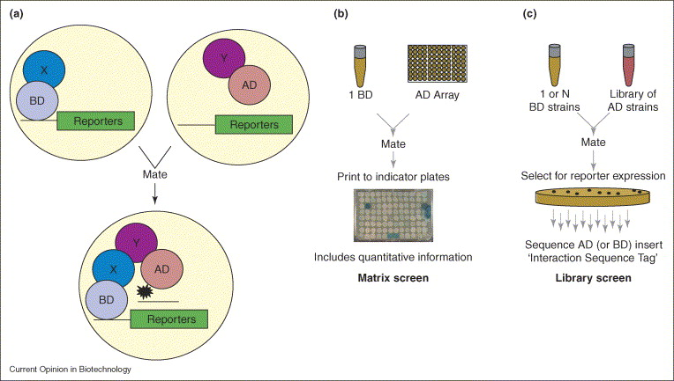
Yeast two-hybrid
X encodes protein A, Y encodes protein B
Interaction X and Y results in blue yeast colonies
Parrish et al. Current Opinion in Biotechnology
Vol 17(4) 2006, Pages 387–393
Notes:
The yeast two-hybrid takes advantage of the finding that many eukaryotic transcription factors can be divided into two functionally distinct domains that mediate DNA binding and transcriptional activation. In the classical yeast two-hybrid approach, a “bait” is constructed by fusing a protein X to the DNA-binding domain (BD) derived from a transcription factor and a “prey” is constructed by fusing a protein Y to the activation domain (AD) of a transcription factor. The bait and prey fusions are expressed in yeast, either they are co-expressed in the same yeast or the bait and prey are brought in the same yeast via mating. In yeast, the interaction of proteins X and Y leads to the reconstitution of a functional transcription factor. Reconstitution of the transcription factor is measured by assaying the activity of reporter genes. Commonly, the lacZ gene encoding bacterial β-galactosidase is used as reporter gene as β-galactosidase enzyme activity can be easily measured using a colorimetric assay.

Slide 27
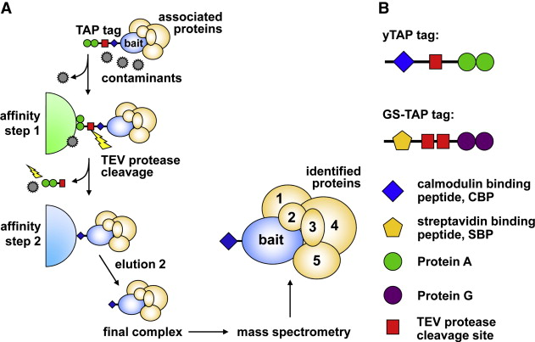
Affinity chromatography
Protein X (bait) + tag → add protein lysate
Immobilise fusion protein → wash away unbound proteins
Remove protein from tag → analyse complex by MS
Veraksa, Journal of Proteomics, Vol 73(11) 2010, 2158–2170
Notes:
Affinity chromatography combined with mass spectrometry to isolate protein complexes and identify interacting proteins. The protein of interest (protein X) is expressed as a fusion protein with a cleavable affinity tag to identify interacting proteins. The affinity tag is able to bind to agarose beads. A protease (e.g. thrombin) is used to cleave between the tag and protein X, which results in elution of all proteins that are specifically bound to protein X. The eluted proteins are resolved by one- or two-dimensional gel electrophoresis. The bands or spots corresponding to proteins specifically bound to the tagged proteins (compared to the control sample where only the tag is used for complex isolation) are excised and analysed by mass spectrometry.

Slide 28
Protein interactions in yeast
Identify all protein interactions in yeast
Yeast two-hybrid
Affinity chromatography + MS
~ 100,000 interactions found between yeast proteins
Most interactions only found using one method
Two-hybrid - pairwise interactions
Tap-tag - protein complexes
Significant fraction of false positives
Combine results of different experiments
Notes:
Currently almost 100,000 interactions between yeast proteins are available from the different high-throughput methods (the exact number depends on filtering criteria). Of these, only a surprisingly small number is supported by more than one method. There are explanations for this. A major difference between the yeast two-hybrid strategy and the affinity chromatography approach is that the yeast two-hybrid system is only used to detect pairwise interactions between proteins. In contrast, an affinity chromatography approach allows subunits consisting of many proteins to be isolated and identified. Furthermore, some types of interactions are difficult to find with a certain method. For example interactions with membrane proteins or transcription factors are difficult to find using two hybrid.
Both methods produce a significant fraction of false positives. A way to reduce this number is to combine the results of several experiments. If one interaction is found several times in different experiments using a different technique the chance that it is a false positive is drastically reduced.

Slide 29
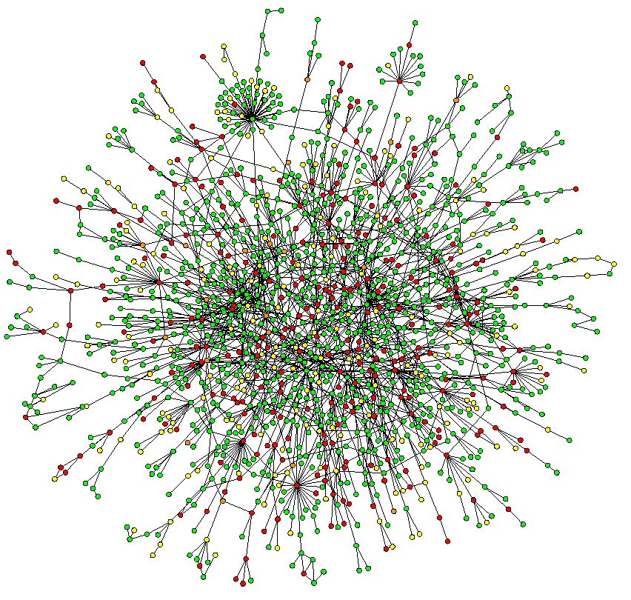
Yeast protein-protein interaction network
http://www.bordalierinstitute.com/images/yeastProteinInteractionNetwork.jpg
Notes:
Characteristics of the yeast proteome. a, Map of protein–protein interactions. The largest cluster, which contains 78% of all proteins, is shown.

Slide 30
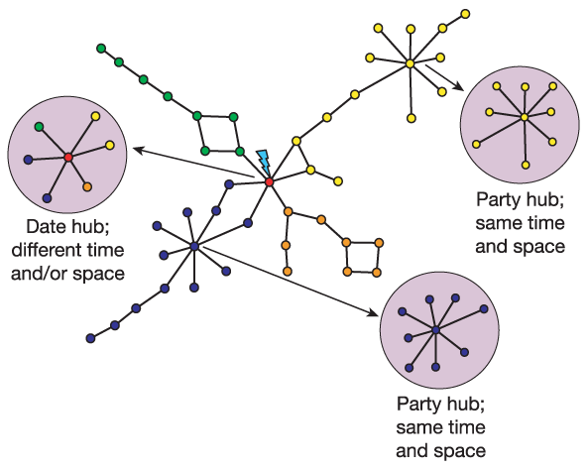
What can you learn from a network?
In protein-protein network:
Protein complexes – ‘party hubs’
Protein modules – ‘date hubs’
Wagner, Nature Reviews Genetics 8, 921-931 2007)
Notes:
Most biological networks are scale free and have a certain amount of modularity. This is also true for protein-protein interaction networks. In these networks modularity can be found back in the formation of protein complexes and protein modules. Protein molecules bind to each other to form stable protein complexes and at a higher level of organisation, proteins and protein complexes interact with preferred partners weakly, transiently or conditionally to form biological modules. For example, scaffold protein that binds together the MAPK phosphorylation complex = party hub. CDC48 = date hub, it can interact with many adaptor proteins and in this way fulfill another function.
Figure: Date and party hubs. In this schematic protein interaction network, proteins are coloured according to mutual similarity in their mRNA expression patterns. Party hubs are highly correlated in expression with their partners, and presumably interact with them at similar times. The partners of date hubs exhibit more limited co-expression and presumably the corresponding physical interactions occur at different times and/or locations. Picture from It is important to distinguish between protein complexes with party hubs and functional modules with date hubs, because they have different biological meanings. Unfortunately, in many cases, it is hard to make a distinction between them in protein-protein interaction networks. Protein networks are for a larger part based on yeast two-hybrid data and these pairwise protein interactions often do not include temporal and spatial information.

Slide 31
Proteomics conclusions
Proteomics = large-scale studies of the protein complement of a genome using a variety of experimental techniques
Proteomics tasks are more diverse than transcriptomics tasks reflecting the wider diversity in protein function
Methods developed for protein separation, identification, structure determination, protein-protein interaction studies, and biochemical properties.
Currently most of the challenges are still in developing experimental methods

Slide 32
Bronnen
Afbeeldingen zijn afkomstig van
Lehninger, 4th ed. Freeman, 2004, ISBN-139: 78-0-7167-43392
Lehninger, 5th ed. Freeman, 2008, ISBN-139: 78-0-7167-7108
Internet: geraadpleegd op 18-11-2012, 31-8-2014 en 12-9-2017
Wetenschappelijke literatuur:
Patterson & Aebersold, Nature Genetics (supp.), 33, 311 (2003)
Parrish et al. Current Opinion in Biotechnology. Vol 17(4) 387–393 (2006)
Veraksa, Journal of Proteomics, Vol 73(11) 2158–2170 (2010)
Wagner, Nature Reviews Genetics 8, 921-931 (2007)
Copyright @ I. Paffen, HAN

